Slide 1
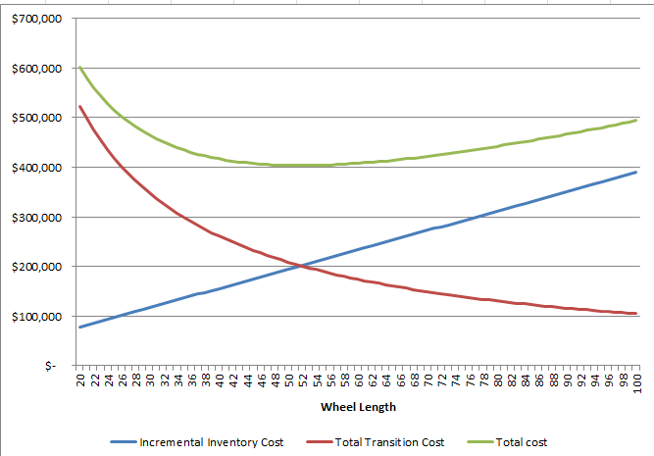
The Product Wheel Tool modeled in Excel Solver determines for each SKU the ‘duration between campaign’ (relates to campaign size) that will give the least overall cost product wheel costs (transition + inventory carrying cost)
Objective: Minimize Product Wheel Cost at SKU level within supplied constraints
Method: Optimize unconstrained first. Then, apply constraints (e.g. target inventory) to get a realistic solution
Key Output from the model: How often to make a SKU i.e. duration between campaigns
Unfortunately we don’t have inventory carrying cost data. So we will only be minimizing transition costs
Example:
As wheel length (or, duration between campaign) increases we make bigger and fewer runs lowering transition costs while increasing inventory carrying costs
At the optimum point Total Product Wheel Cost is the least (usually around the intersection point of the curve)

Slide 2
Corian – Primary Findings
Product/family groupings
Families are a potentially useful way to group products—based on kernel density estimates and similar transition relationships when grouping by families or products
Two ways of forecasting/punting transitions:
Forecasting based on the interquartile range that describes family & product groups
43% of transitions have been performed 10 or more times in terms of family
6% of transitions have been performed 10 or more times in terms of product
Estimated transition sheets saved ~10,000 / year
Forecasting on “rolled up” clusters (product groups rolled into 3 categories)
Identified 3 clusters based on IQR and median
New product transitions can be “binned” into most unpredictable cluster (cluster 3) to forecast

Slide 3
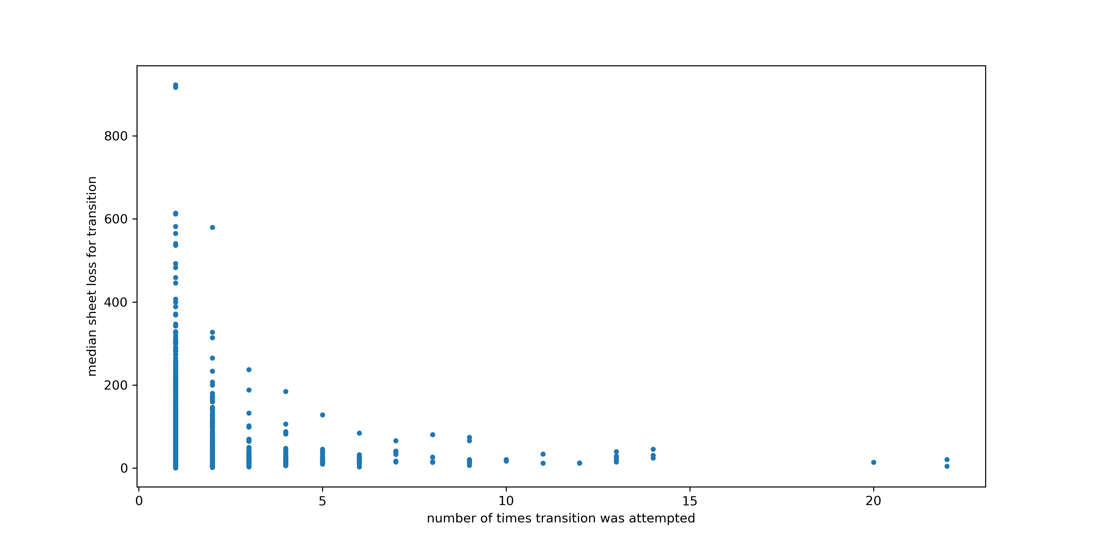
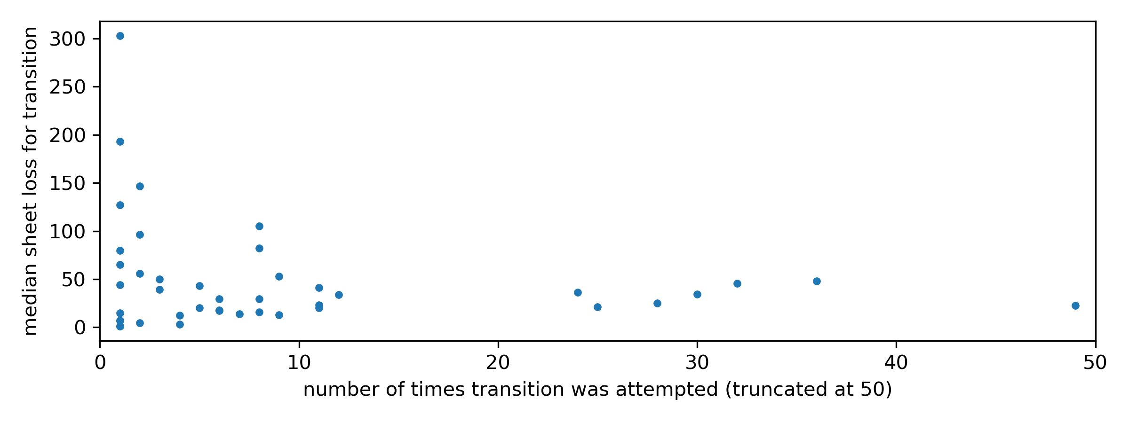
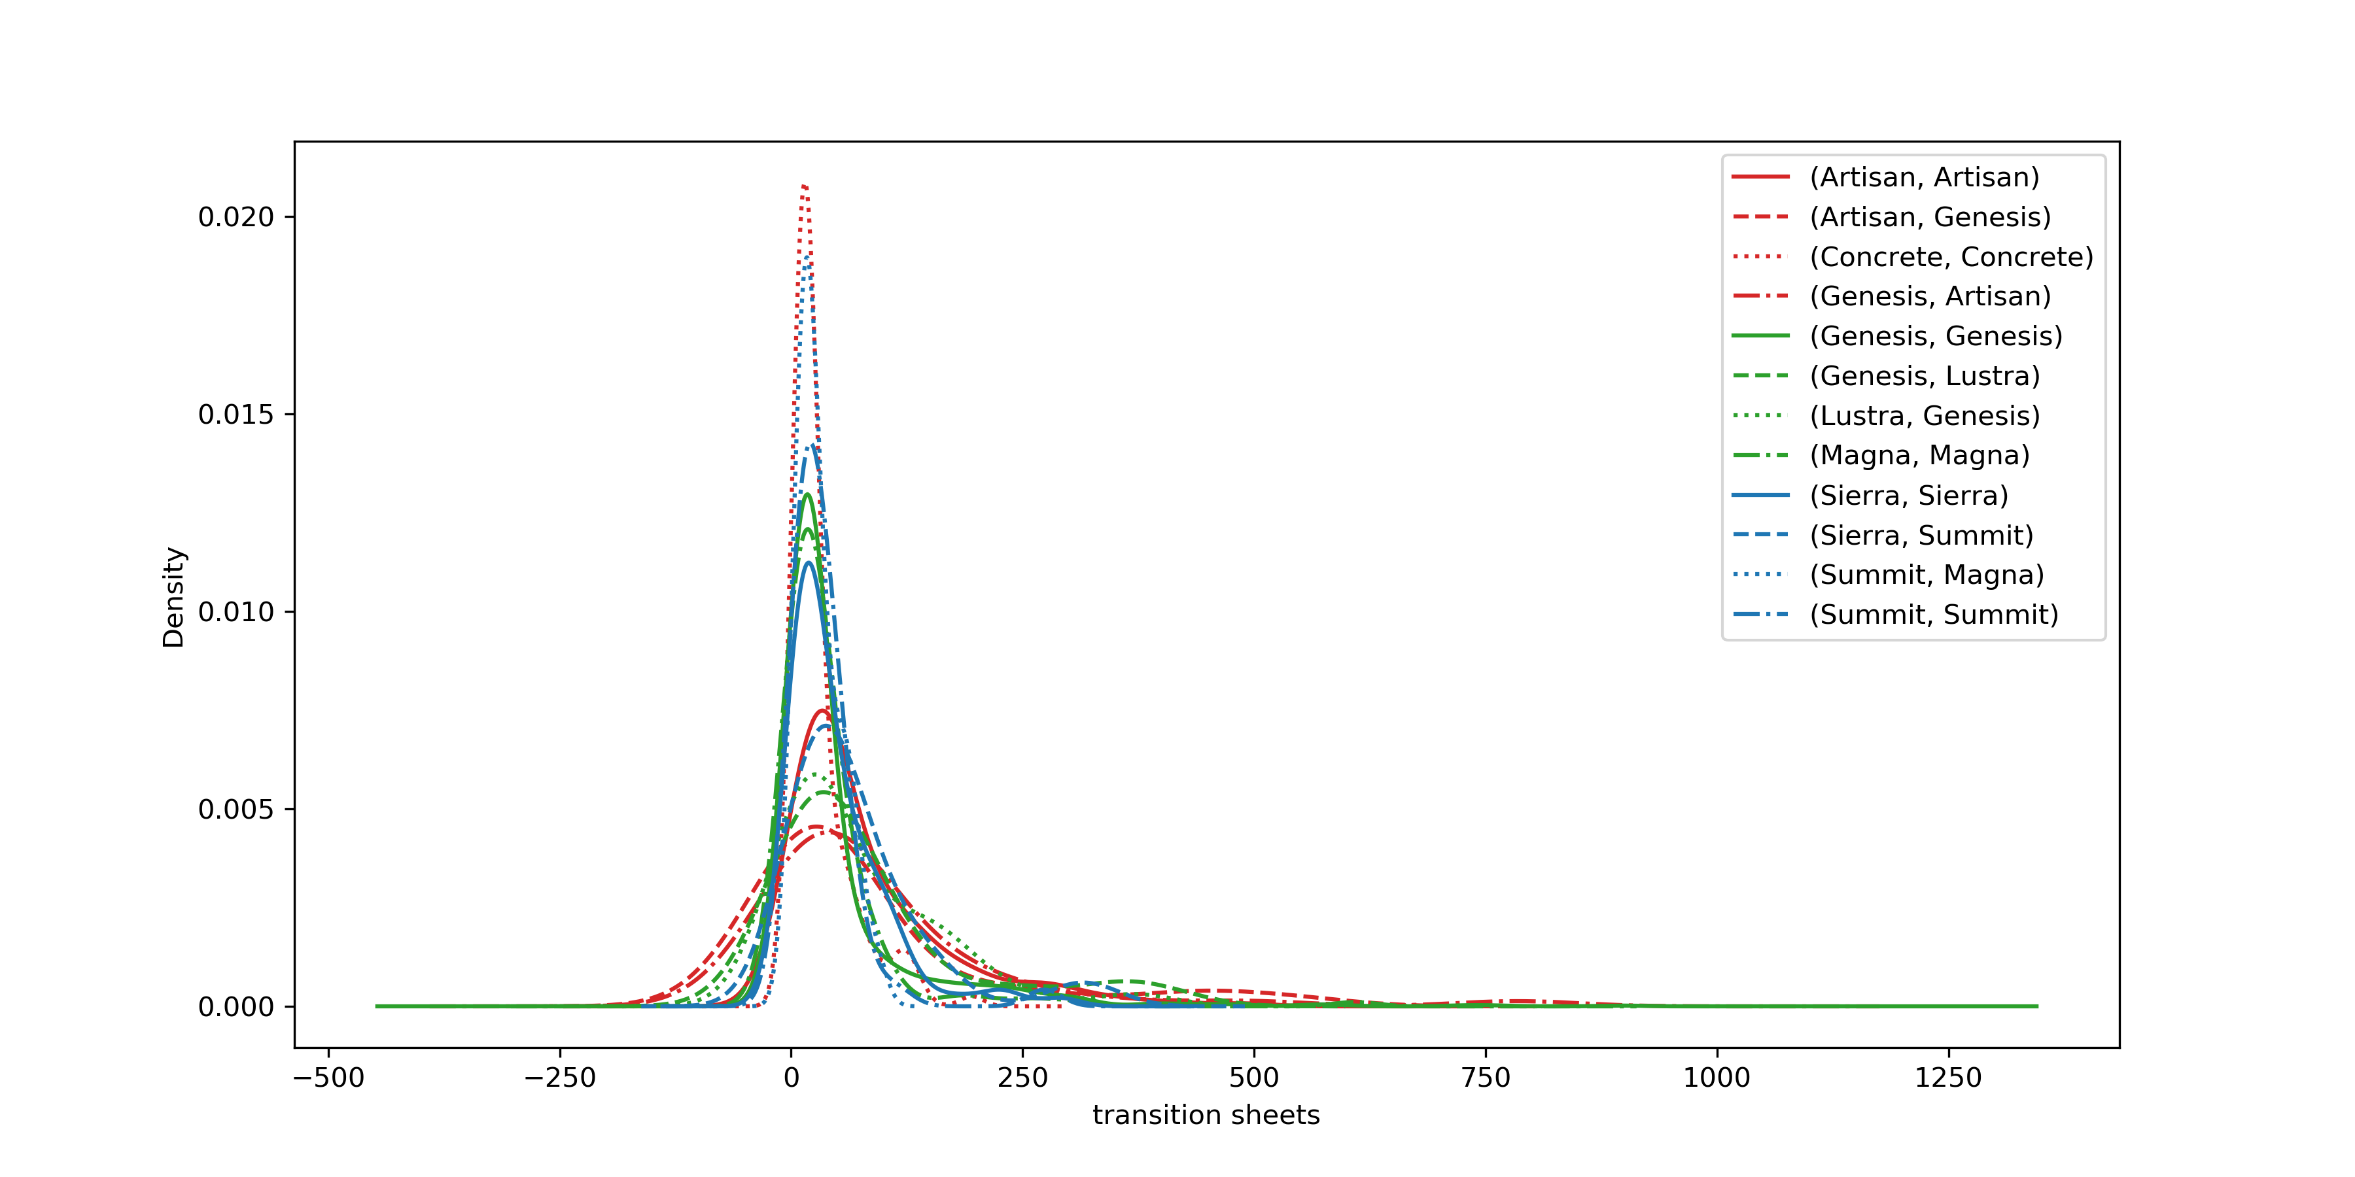
I. Product/Family Groupings
Establishing products/families as groups
By Family
Scatter (top):
Dataset is grouped by product-to-product transition, plot is the median of the A->B transition losses vs the number of times the transition was made in a 2-year period. Inset is same, distinguished by family.
Kernel density estimate (KDE) (bottom)
Gaussian deposits are made on x-axis for every data entry where given family-to-family transition was made
Smoothing function is applied across gaussian deposits; portion of curve extends beyond 0 though non-real
Probability distributions are normalized by the total amount of data (tall peaks centered near 0 indicate reliable transition profile)
By Product
Evaluation:
Specific product-to-product and family-to-family transitions improve with number of attempts
Behavior may be explained by scheduling preference for transitions known to perform well (discuss with engineers)
Transition attempts vs transition sheets should be an included relationship in the risk-reward evaluation for exploring (finding) better transition routes
Bimodal distribution on transition sheet loss for inter/intra family transitions
Inter family transition sheet losses are greater
Family-based transitions should be a valuable approach to ‘filling in’ data cavities in transition matrix
predominantly intra family
predominantly inter family

Slide 4
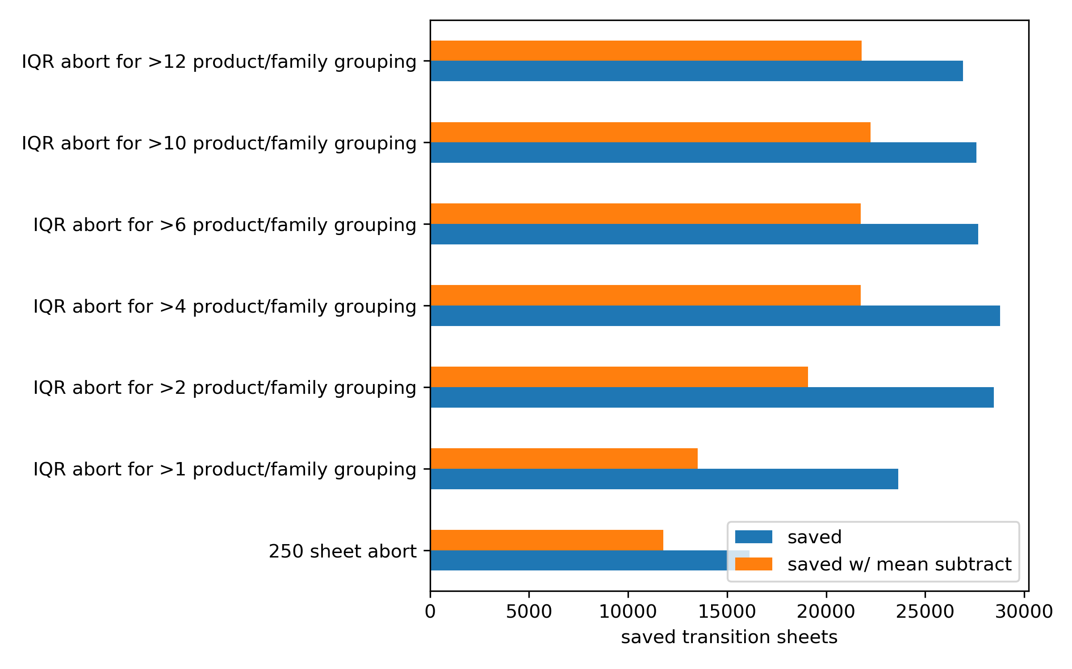
II. Forecasting based on the interquartile range that describes family & product groups
Algorithm
If transition sheets exceeds 1.5 * IQR + median for either family or product category, then abort the transition
Else if transition sheets exceeds 250 then abort the transition
To calculate the sheets saved subtract the mean transition sheets from the delta above the cutoff to simulate the number of sheets lost to transition after an abort a new transition trial (i.e. add back an assumed loss)
Identifying product/family group size to determine expected transition sheets
Explanation
Using more than 10 data points to compute family/product transitions gives the lowest spread between saved sheets and saved sheets w/ penalization
Using less stringent statistical criteria results in aborting transitions that are below the average of the dataset as a whole, i.e. these are probably not runaway transitions that should be aborted
If IQR based on too little data:
‘outliers’ incorrectly labeled as ‘in range’
Reason for upward trend in sheets saved from >1 to >4 groups
Aborting transitions that are less than the average transition sheets for whole dataset
Reason for >6 to >10 decrease in ‘saved sheets’ but increase in ‘saved sheets w/ mean subtract’
If IQR based on too much data (i.e. >12)
Excluding data that could’ve resulted in valuable screening

Slide 5
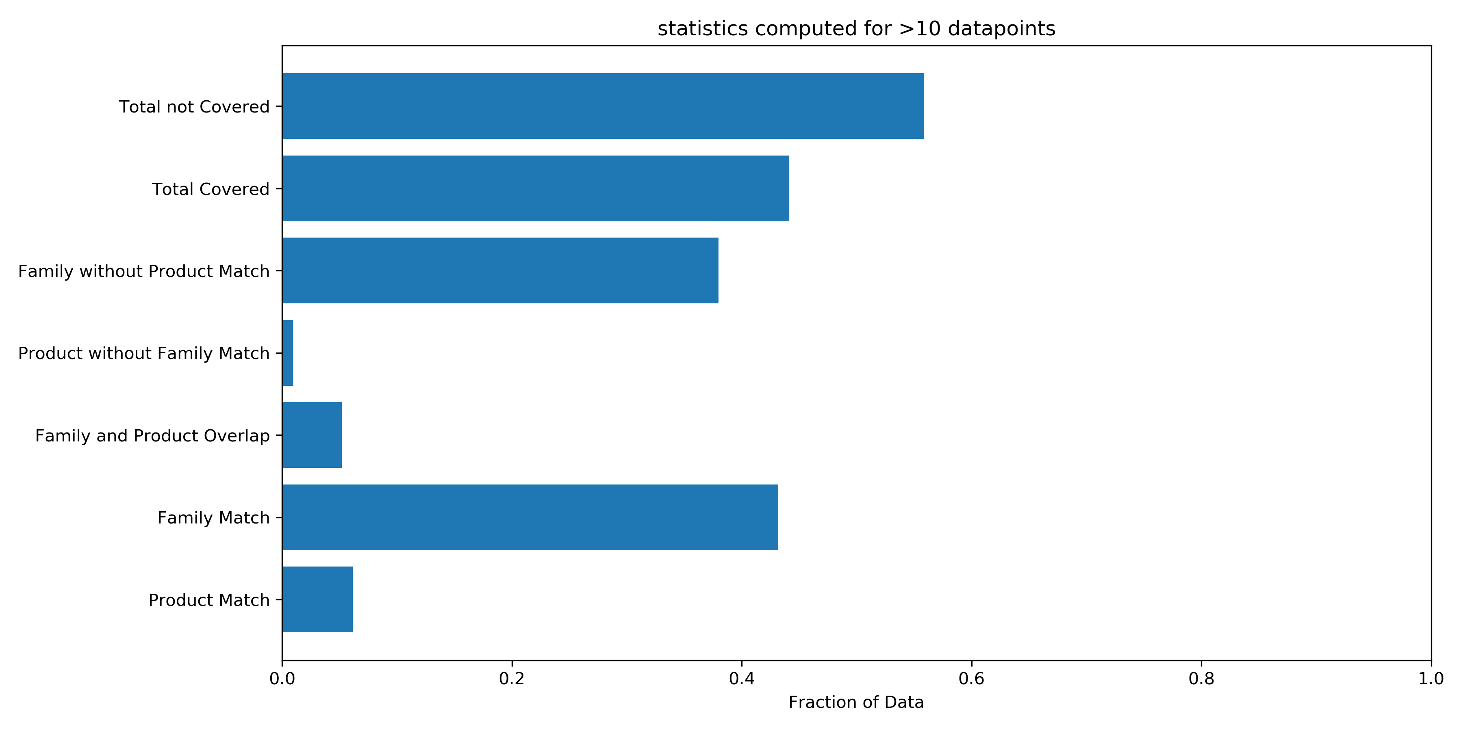
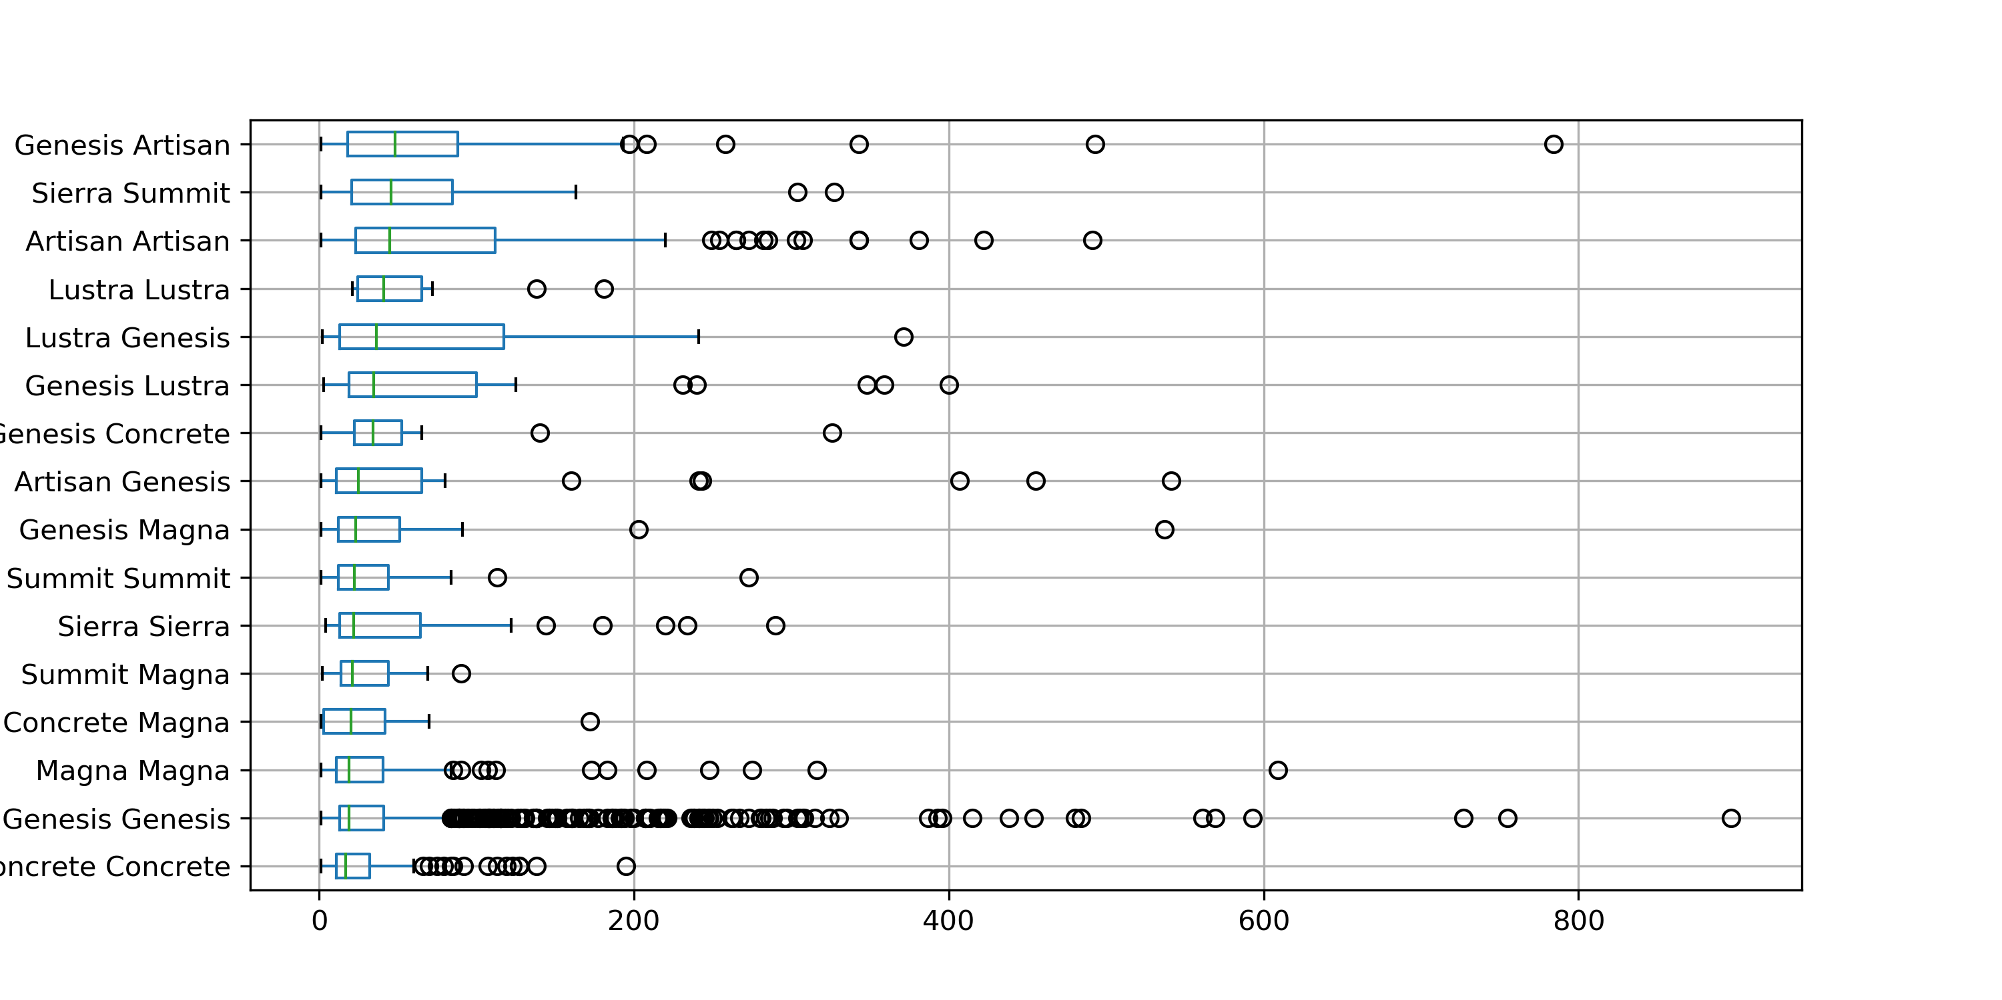
II. Forecasting based on the interquartile range that describes family & product groups
Pareto-ing out origin of outlier screening
Explanation
Product and family statistics computed for 10 or more transitions
43% of transitions have been performed 10 or more times in terms of family
6% of transitions have been performed 10 or more times in terms of product
Value Proposition
Algorithm as described results in:
Mean transition sheet loss for entire two-year period reduced from 46.7 sheets to 35.7 sheets (23.4% reduction on average)
22249 transition sheets avoided (15% of total transitions sheets) in 2-year period
40 jobs aborted due to exceeding product-wise cut-off, 58 jobs aborted due to exceeding family-wise cut-off, 51 jobs aborted due to exceeding 250 cut-off
Similar analysis applied to simple 250 cut-off results in:
21.7% reduction in sheet loss average, 119 aborted jobs, 11788 saved sheets (8% of total transition sheets)
Black circles – upper box whisker = saved sheets

Slide 6
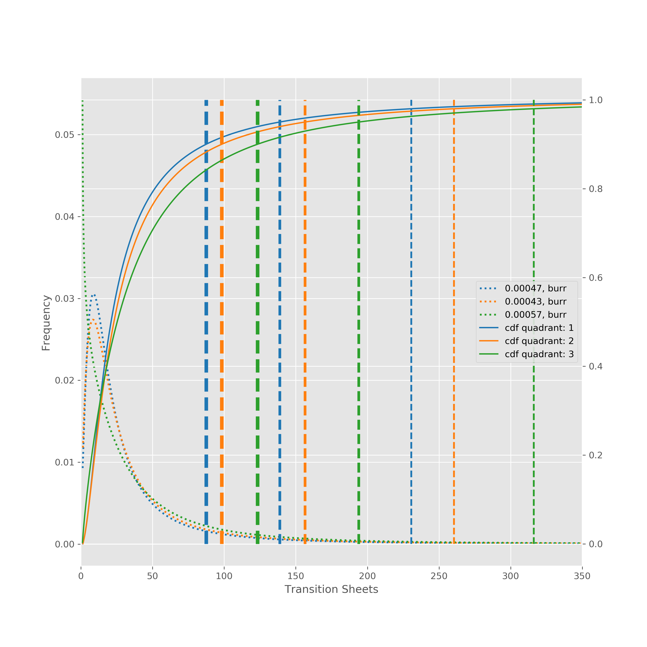
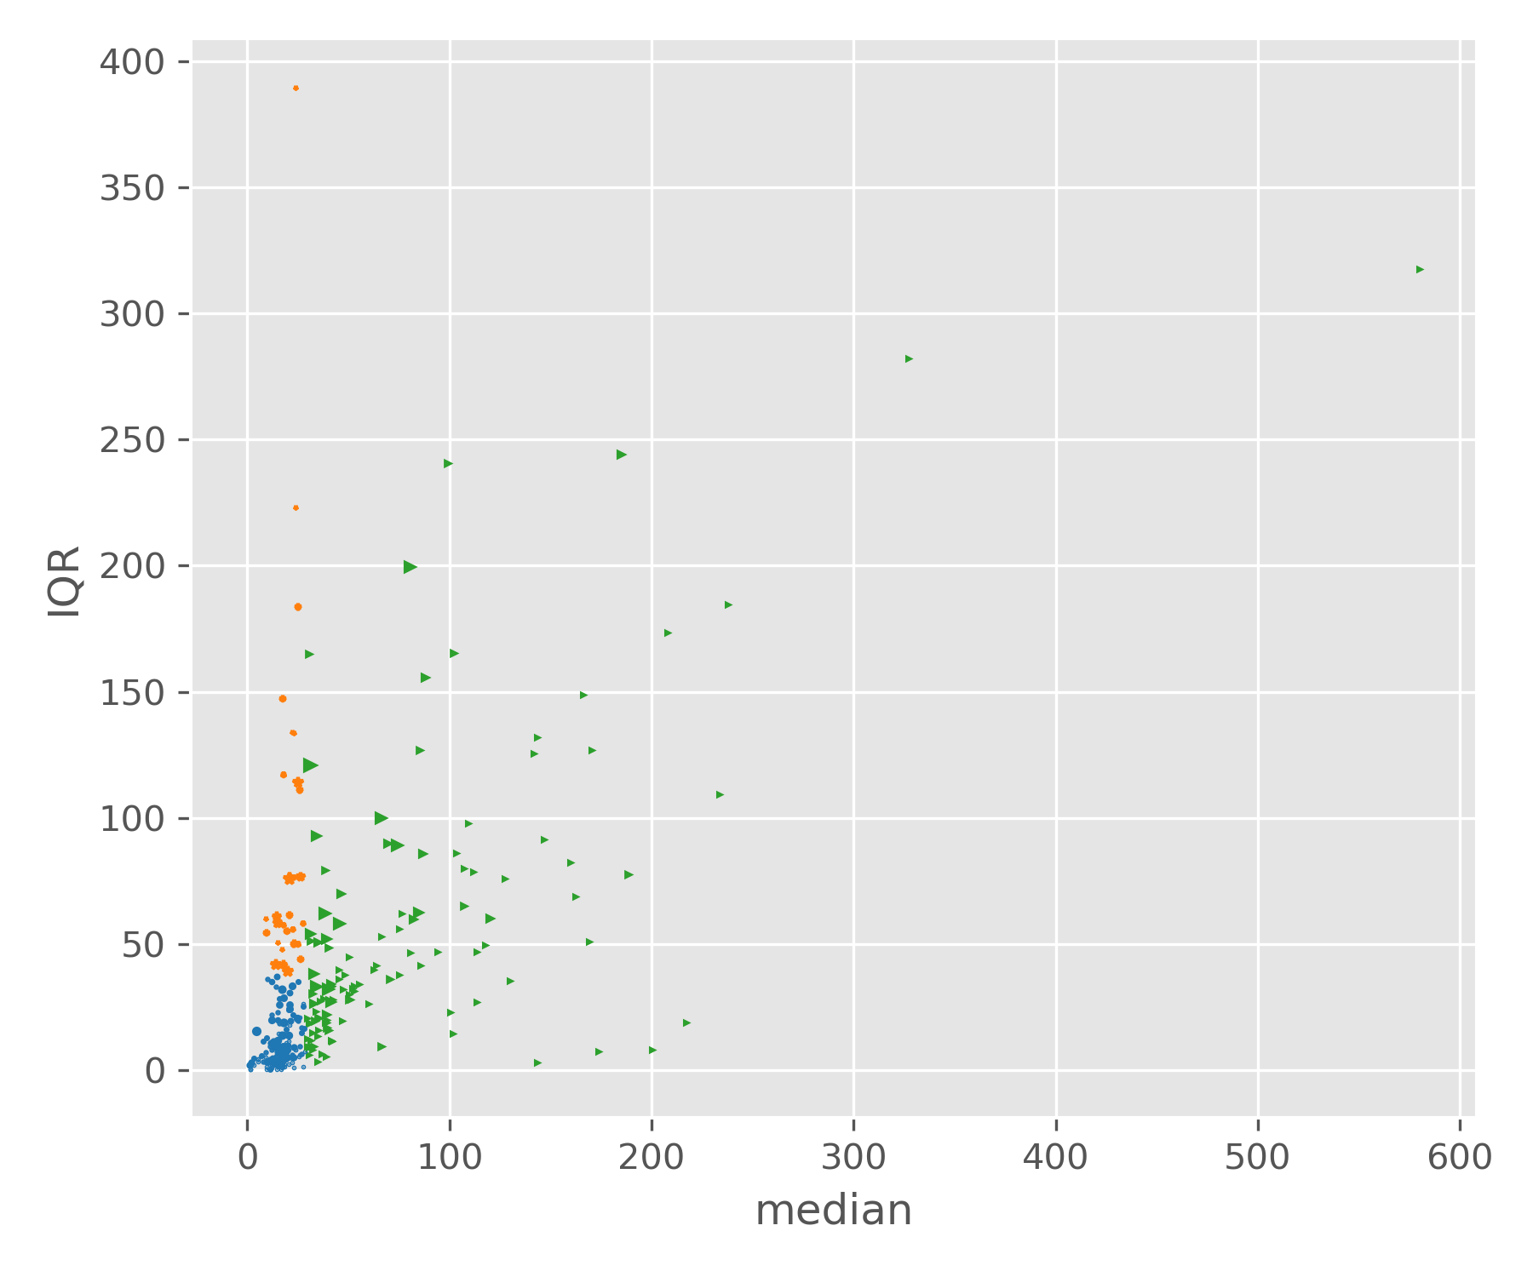
III. Forecasting on “rolled up” clusters (product groups rolled into 3 categories)
Product -> product transitions plotted against IQR and median
Selected 3 different clusters:
IQR cutoff = 38
Median cutoff = 29
Beginning-of-week performance can be forecasted based on cluster profile of the schedule
End-of-week performance compared to forecast to diagnose and identify special events
Abort/punt can be determined by current transition sheet loss position in the appropriate distribution
90th, 95th, and 98th percentiles indicated by vertical lines
CDF in solid line
PDF in dotted line
Ex performance review: “we were outside of the 98th percentile of one of our third cluster transitions; why?”

Slide 7
Appendix

Slide 8
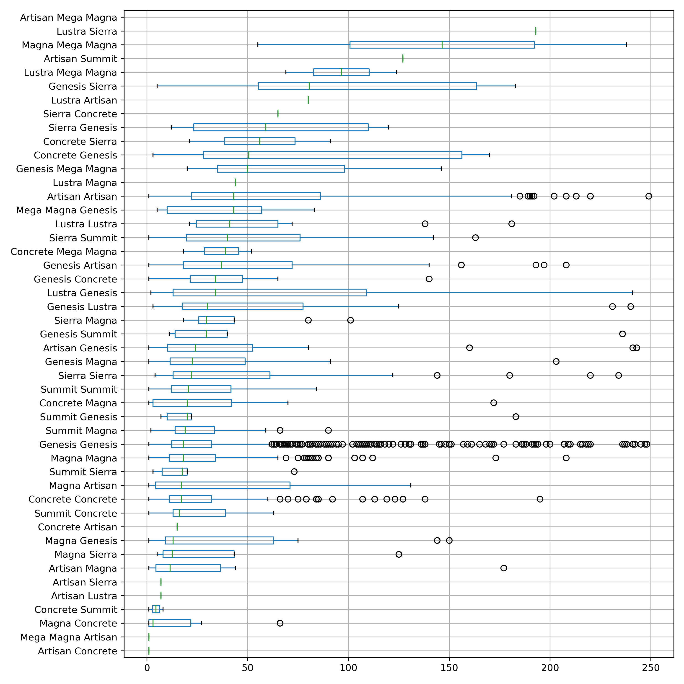
II. Abort (Punt) Algorithm
Resulting transition profile from abort algorithm removes throw-outs (special causes) and reveals true distributions (common causes)

Slide 9
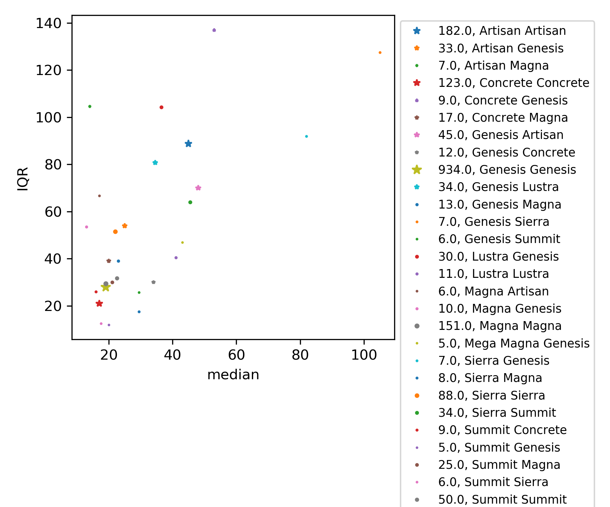
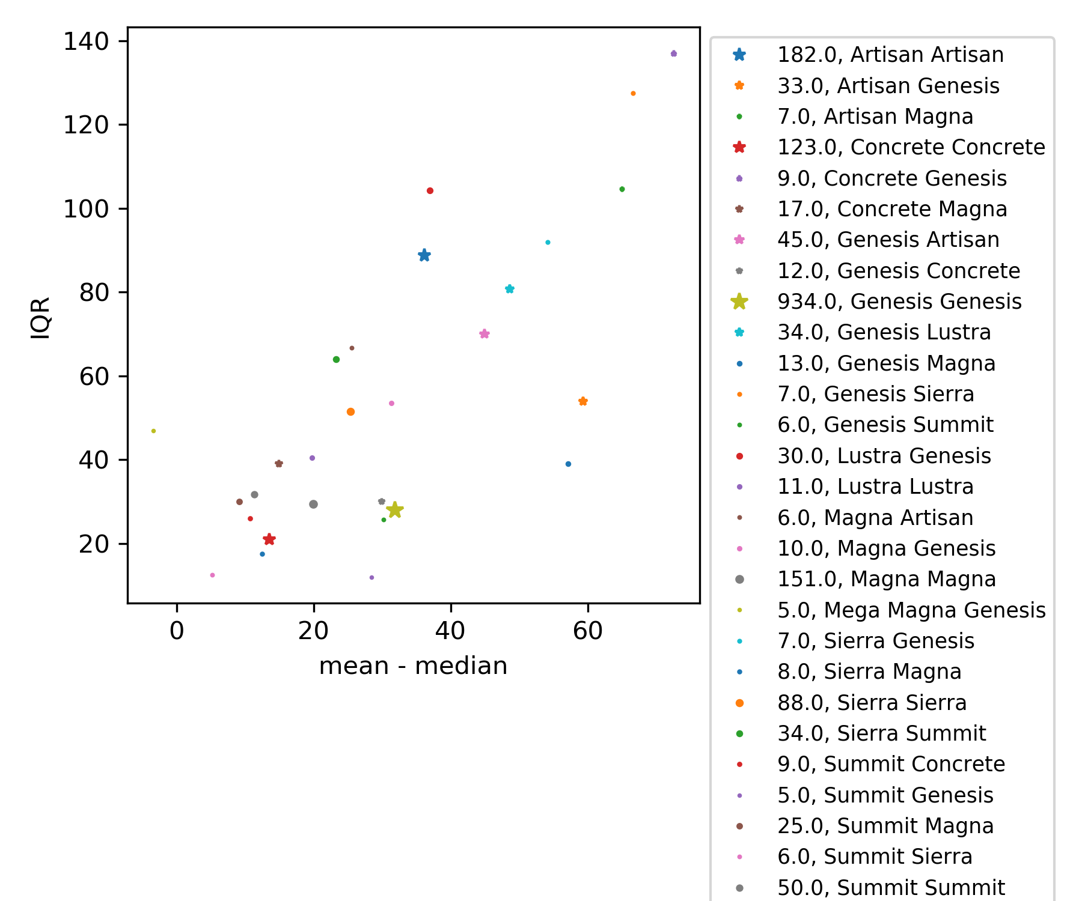
III. Forecasting on Quadrants – Grouping by Family
Low median, tight distribution
Low median, broad distribution
High median, tight distribution
High median, broad distribution
II.
IV.
I.
III.

Slide 10
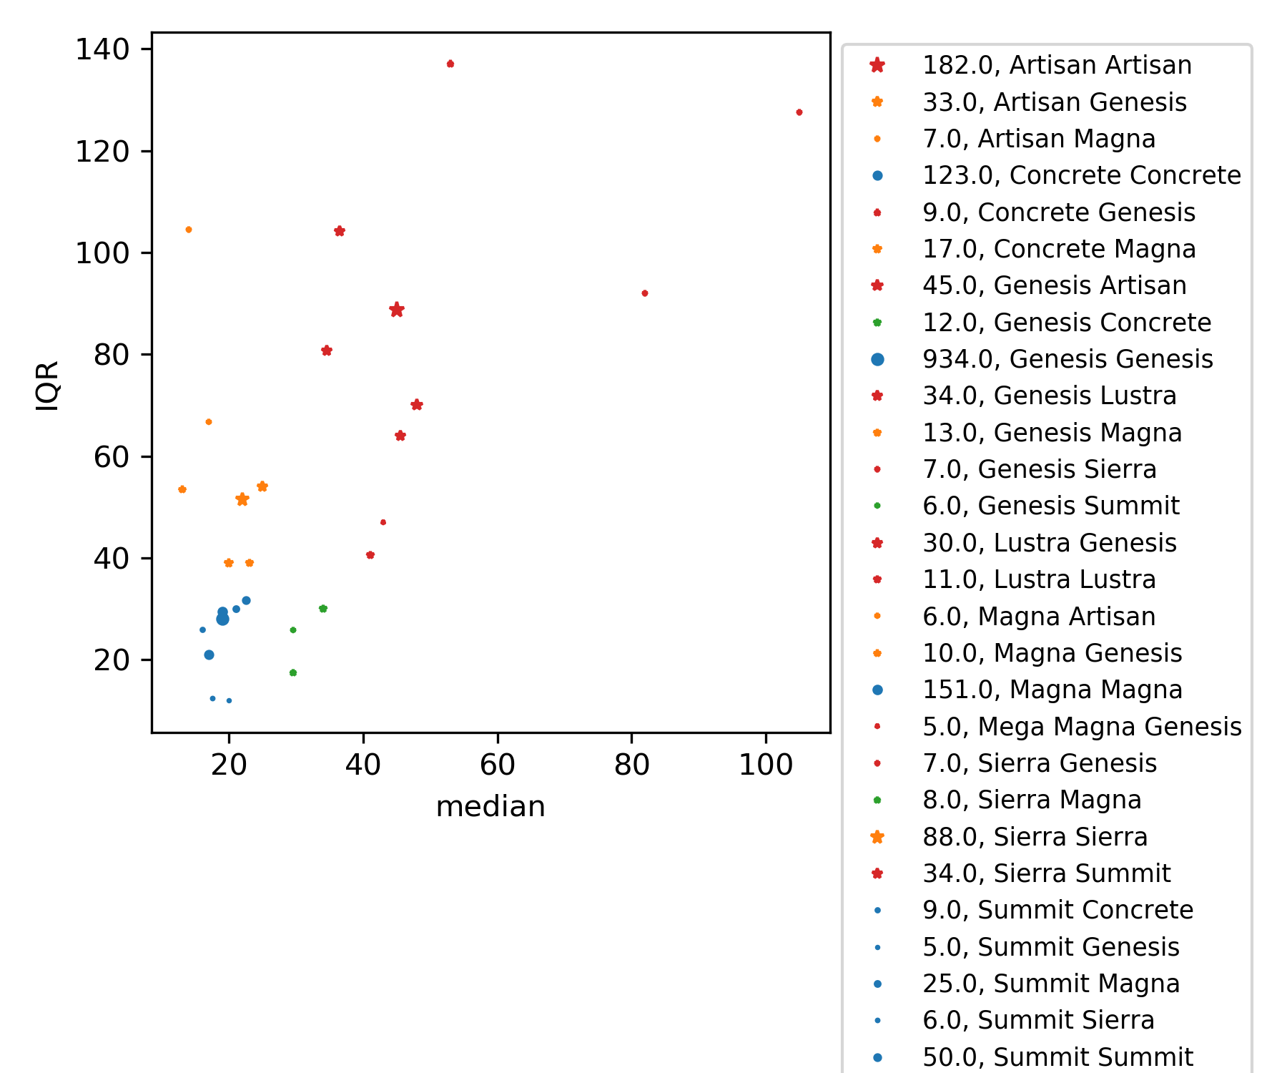
III. Forecasting on Quadrants – Grouping by Family
Low median, tight distribution
Low median, broad distribution
High median, tight distribution
High median, broad distribution
II.
IV.
I.
III.

Slide 11
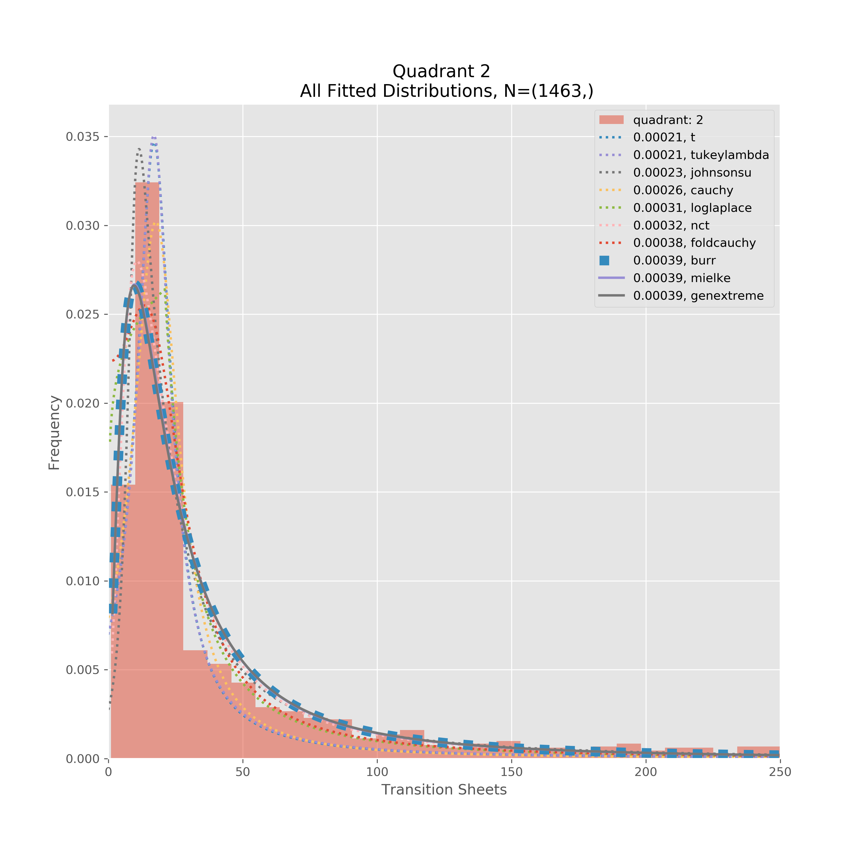
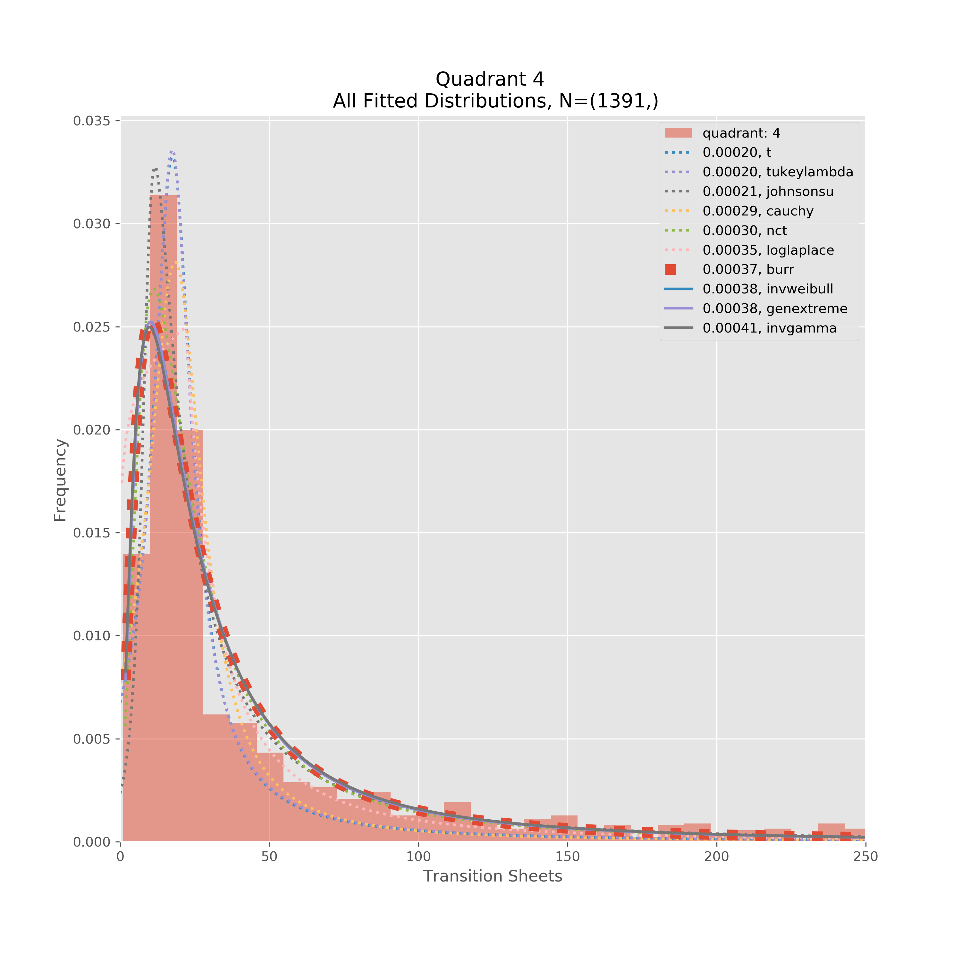
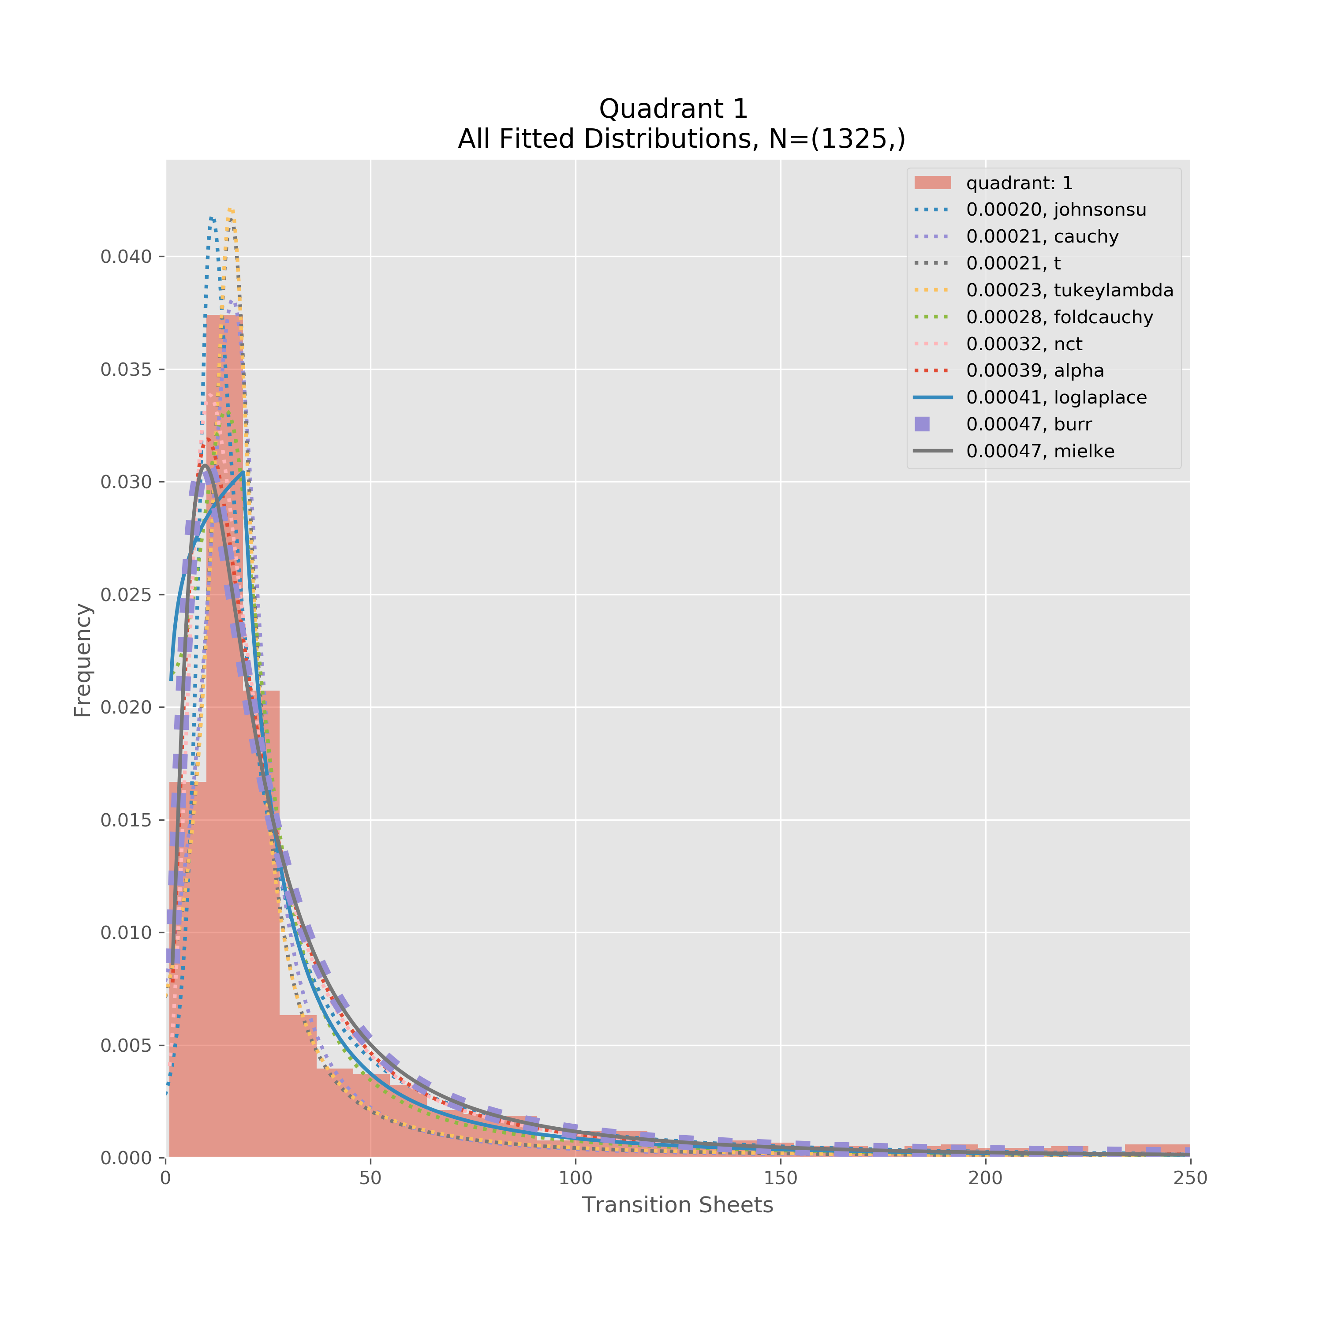
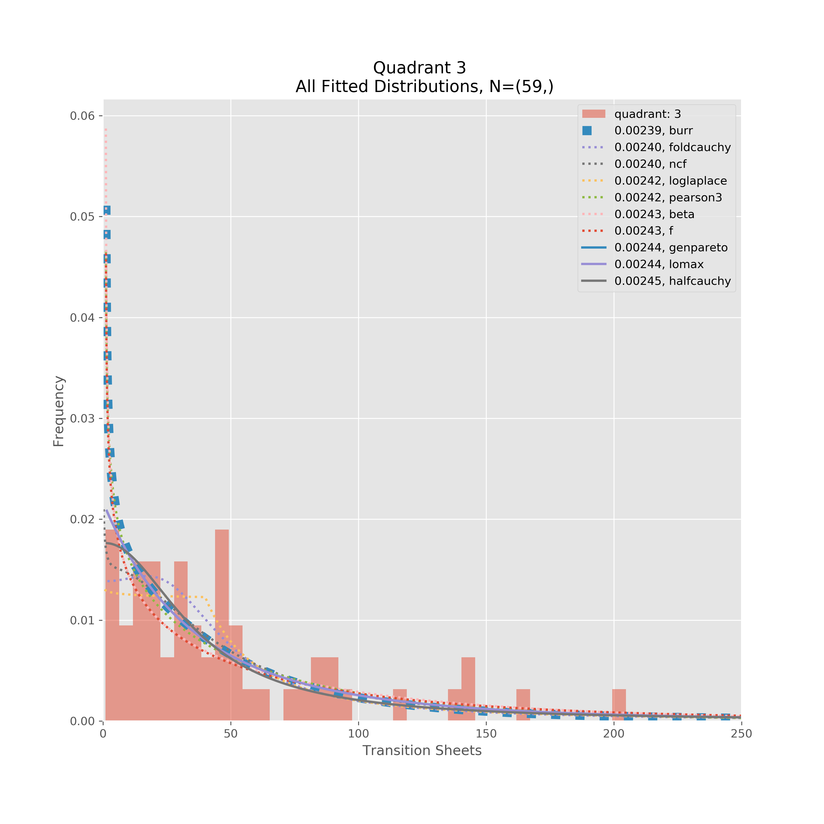
III. Forecasting on Quadrants – Grouping by Family
2-parameter ‘Burr’ distribution highlighted as common distribution between all quadrants
Not enough data in 3rd quadrant; order of magnitude higher sse for all top 10 fits
We either omit quadrant 3 or group with another quadrant

Slide 12
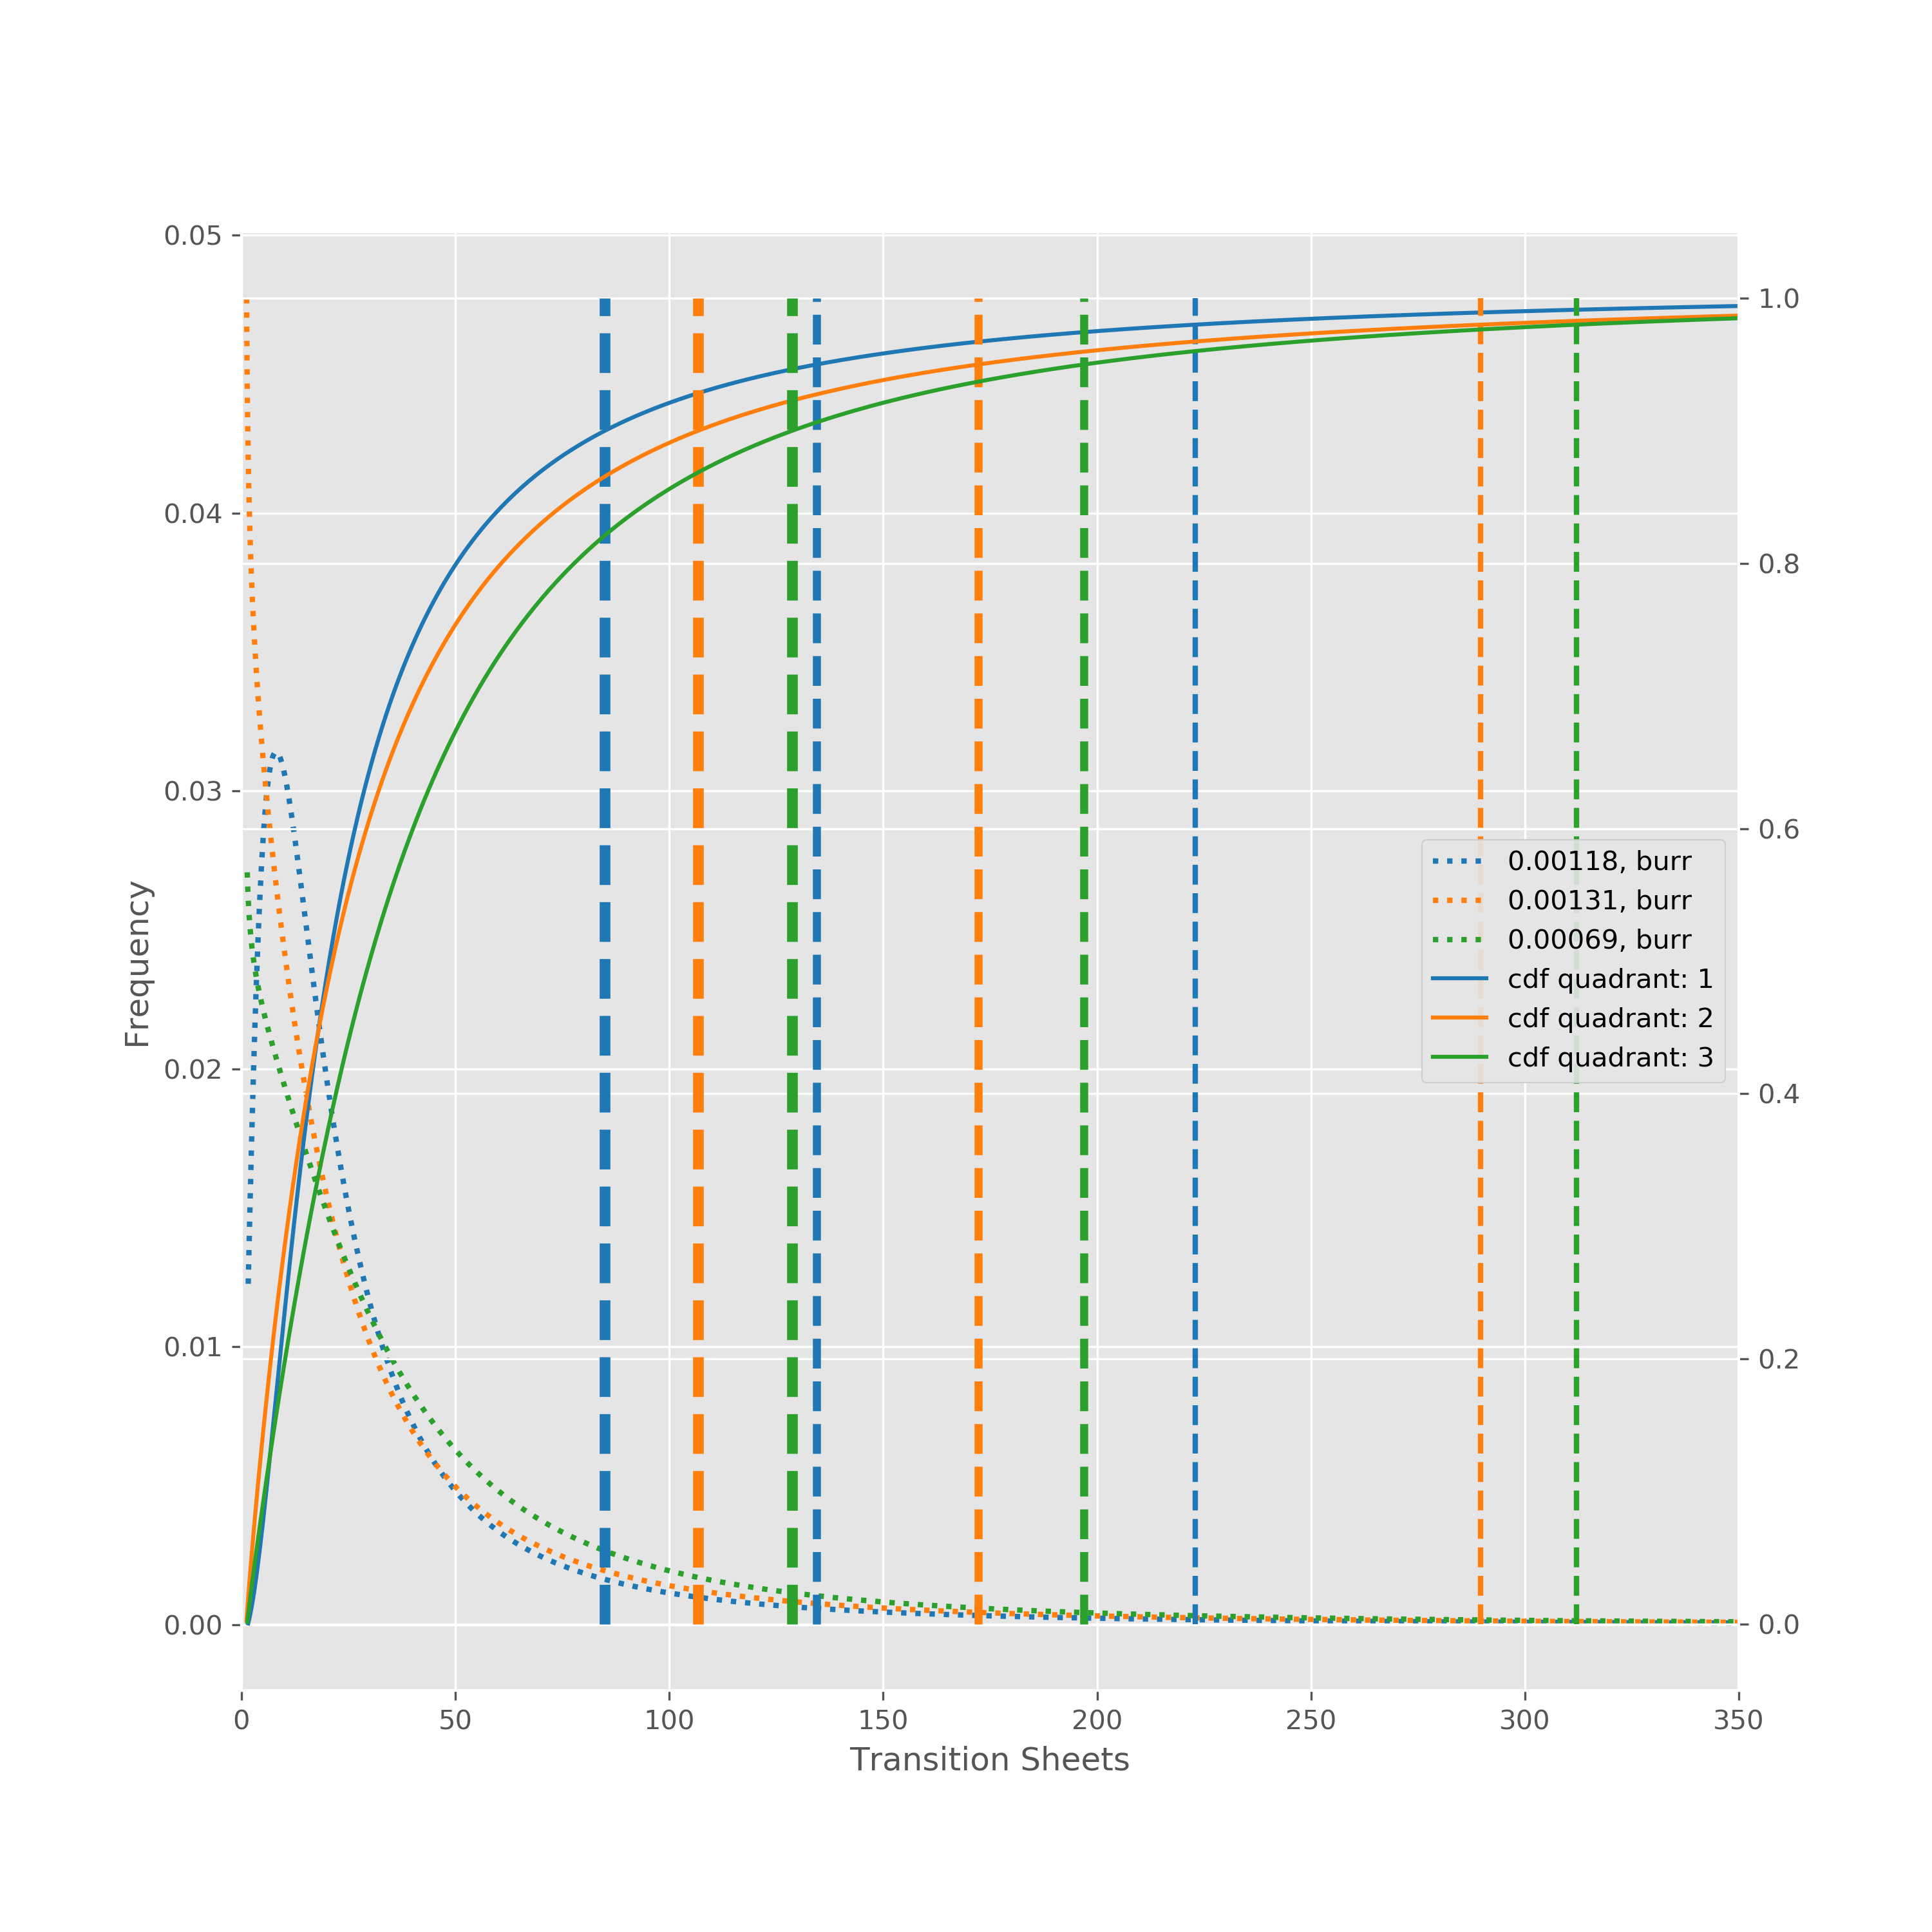
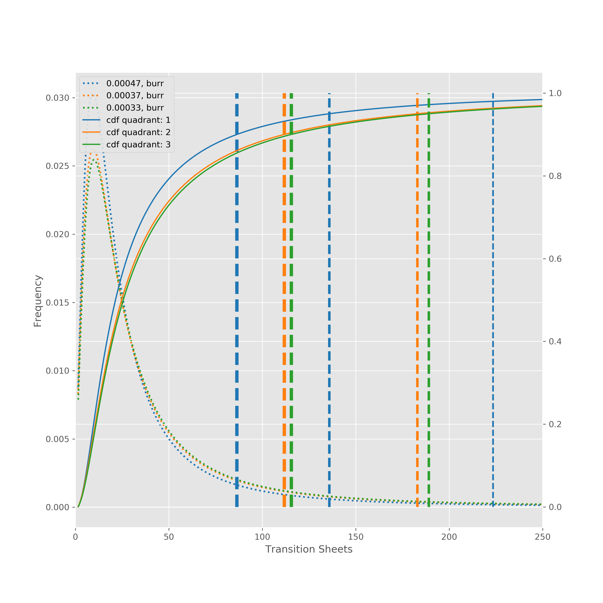
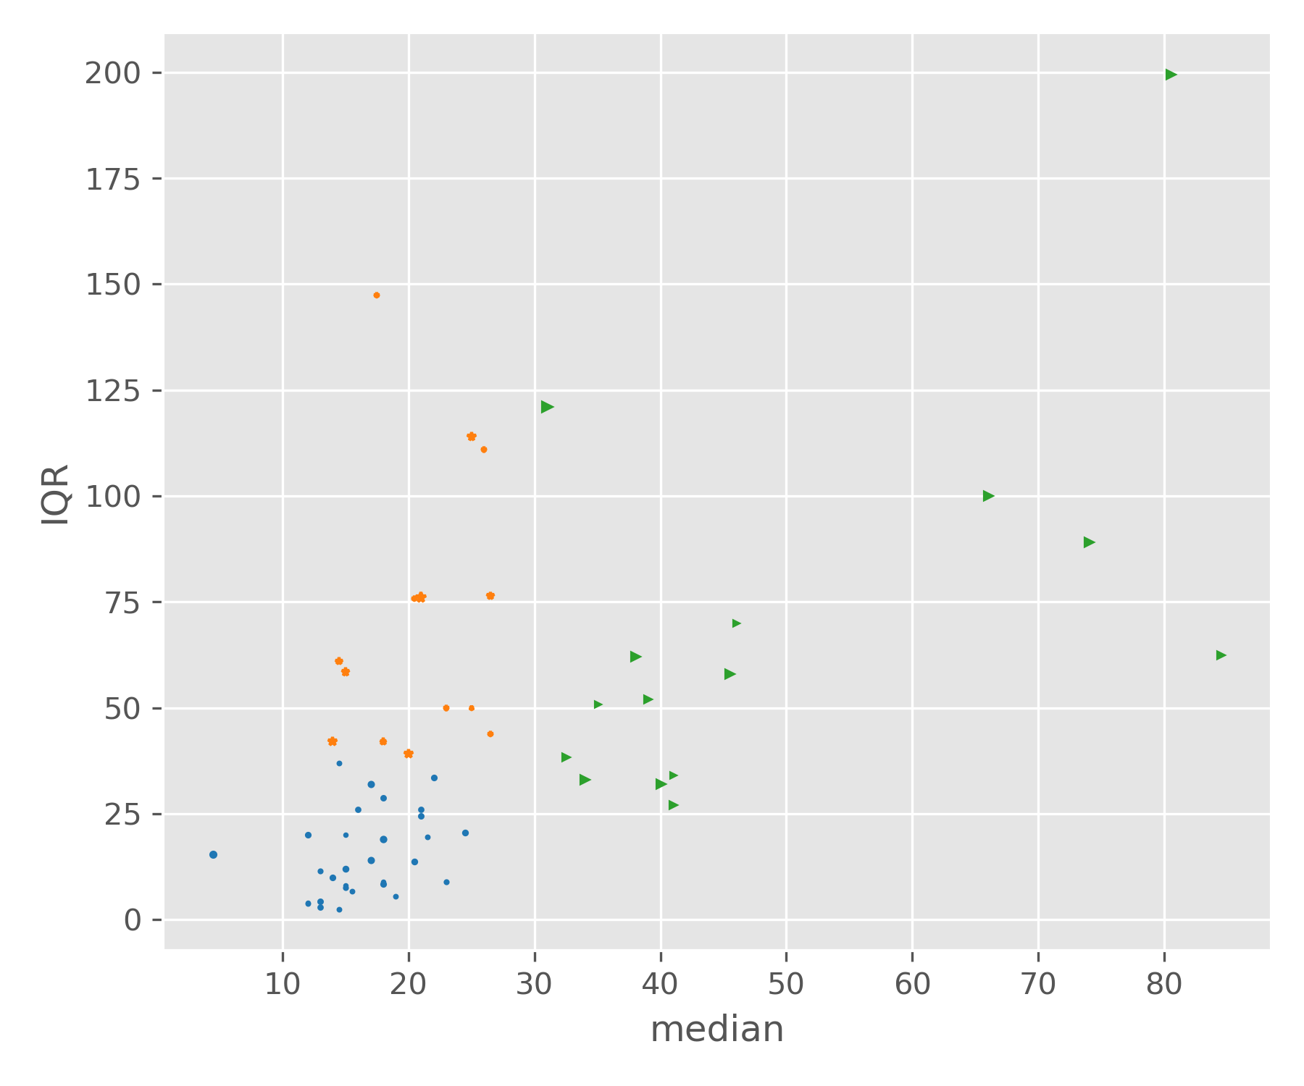
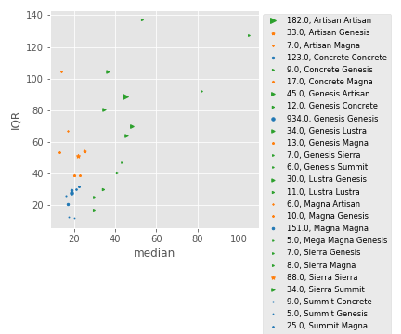
Same analysis repeated for 3 clusters on products (left) and families (right) and all data (below)
Very similar behavior; robust clusters

Slide 13
III. Forecasting on Quadrants
Alternative quadrant determination could be made by calculation of distance to origin; the further from the origin the more unpredictable the transition

Slide 14
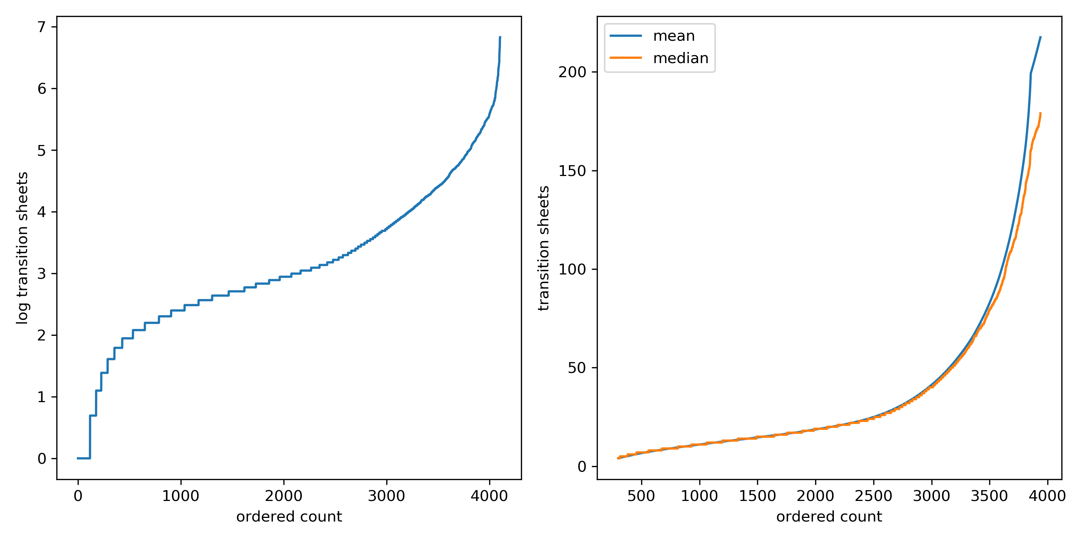
Separating Common From Special Causes
500 count window for moving average and median
Transition sheet distribution changes from normal to tailed the further along in total transition sheets for ordered dataset and creates spread in mean/median; performance worsens and likelihood of a long transition sheet period increases
Two inflection points in log-scale indicate performance change; motion from common to special cause in performance behavior
High risk operation
Moderate risk operation
Low risk operation

